Slide 1
Creating Career Pathways for Professional Services Staff
Claire Hunter

Slide 2
Introduction
This presentation will
    illustrate how career pathways have been implemented at Durham University
    explain collaboration with representatives from each Job Family and the Accommodation and Commercial Services Department
    illustrate how career pathways
      provide a way to identify other job roles / skills & knowledge required for progression
      identify relevant internal development opportunities & external qualifications
    show qualitative evidence of impact that demonstrates return on investment/expectation
    demonstrate a framework that can be adopted by other organisations.

Slide 3
Background
The launch of the Job Families framework for Professional Staff in 2018 provided an opportunity to create associated Career Pathways.
The Human Resources and Organisation Development (HR-OD) team in collaboration with working groups from across the institution, developed a number of resources to provide clarity about the skills, knowledge and experience required in different job roles.
They also created associated career pathways for all Professional Staff groups to help staff identify potential career development opportunities across the University.
HR-OD have worked with Accommodation and Commercial Services on a succession and talent management approach since 2016 and this work then supported the further development of the career pathways approach for the rest of the institution which was launched in 2019 and is included in the Technicians Commitment work at Durham.

Slide 4




We now have 4 Job Families for Professional Services Staff – (see below) resulting in a reduction of 1119 different job descriptions to 64 core job profiles and requiring all members of PS to gain a new job description in 2018
Business, Process and People Services (BPPS)
Roles in this family provide a comprehensive service and deliver the efficient administration and governance of the University
Technical Research and Teaching Services (TRTS)
Roles in this family provide creative and analytical input to facilitate the delivery of world-class teaching, learning and research activities
Community, Participation and Engagement Services (CPES)
Roles in this family provide an excellent stakeholder experience for our diverse and supportive community
Estates and Information Infrastructure Services (EIIS)
Roles in this family manage and maintain the integrity of University buildings, estates and information services

Slide 5
How did we identify career opportunities and career pathways?
Introduction of consistent job descriptions provided transparency over role, behaviour and skills requirements at every grade across the whole institution for some 2200 members of staff.
Core pathways for each Job Family have been developed to illustrate the variety and diversity of roles that are available within the University.
Specialist career pathways have also been developed focusing on potential opportunities within specific departments.
All pathways are interactive with links to further information on the requirements of specific roles and can be viewed at https://www.dur.ac.uk/od/strain/careerpath/
An example of the career pathway developed with the Accommodation and Commercial Services team who have roles in 3 of the 4 families is demonstrated on the next slide.

Slide 6




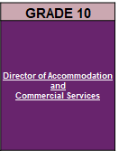

Accommodation and Commercial Services Career Pathway
GRADE 1
Housekeeping and Cleaning Assistant Postal and Delivery Services Assistant
No jobs at this grade
Business Support Apprentice University Retail Support
GRADE 2
General Services Assistant
No jobs at this grade
University Retail Administrative Assistant
GRADE 3
No jobs at this grade
Reception Helpdesk Assistant
Senior Business Support Assistant Senior Event Durham Assistant
GRADE 4
Housekeeping and Cleaning Services Supervisor
Reception Helpdesk Supervisor
Facilitator (Accommodation and Facilities Services)
GRADE 5
General Services Team Leader Postal and Delivery Services Team Leader
Event Durham Coordinator (Sales) Event Durham Coordinator (Corporate) Event Durham Coordinator (Customer Relations) Event Durham Coordinator (Event Management)
Personal Assistant Programme Coordinator Business Support Team Leader Business Systems Analyst University Retail Team Leader Estates and Facilities Relationship Coordinator
EIIS
CPES
BPPS
GRADE 9
No jobs at this grade
No jobs at this grade
Head of Estates and Facilities Relationship Management Head of Health and Safety Services
GRADE 8
Senior Housekeeping, Cleaning and General Services Manager
Senior Events and Customer Services Manager
Health and Safety Business Partner Senior Systems, Revenue and Information Manager Senior Business Services Manager (Estates and Colleges) Senior Business Resilience Manager Senior Business Support Manager
GRADE 7
Housekeeping, Cleaning and General Services Manager
Reception Helpdesk Manager Event Durham Manager
Estates and Facilities Relationship Manager Business Resilience Manager Health and Safety Compliance Manager (Estates)
GRADE 6
No jobs at this grade
Assistant Event Durham Manager
Assistant Fire Safety Manager
There are other roles within these Job Families
for roles within BPPS click here
for roles within CPES click here
for roles within EIIS click here.
ACS July 2019 NP/CO

Slide 7
How does a member of staff identify their development needs to enable them to follow their desired career pathway?
64 online Personal Development workbooks were created in PebblePad to support each core job profile so that individual development needs can be highlighted against;
  the core skills for the job role linked to the University strategy and values as described in the Job Families,
  the personal behaviours from the Durham Realising Your Potential Approach behaviours framework
  and the role specific skills by working through the that complement this approach. https://www.dur.ac.uk/od/strain/cpd/pdworkbooks
Each pathway is supported by a comprehensive blended training and development offer and suggestions of other development opportunities so it is easy for staff to identify what options are available to support skills and personal development requirements.
The University Executive has endorsed a minimum 21 CPD hour allocation (pro rata) to all PS staff to ensure that their development is supported.

Slide 8
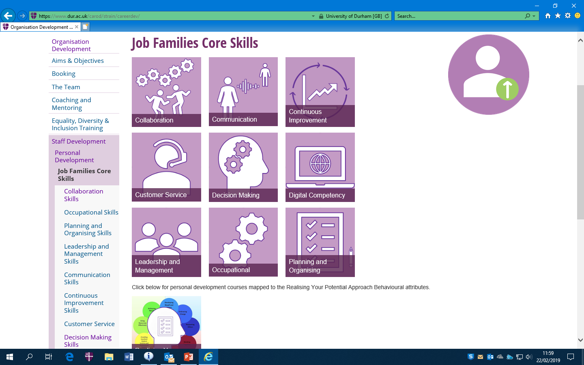
All four Job Families core
profiles were analysed
and these are the 9 core skills
that all members of PS staff
would need to be able to
demonstrate.
The L&D offer has been completely refreshed and there is now a comprehensive
development offer available for all PS staff underpinning each of these core skills. This can be accessed at https://www.dur.ac.uk/od/strain/careerdev/

Slide 9


Individual responsibility to complete the
Personal Development workbooks: three specific TNAs
Core skills+RYPA+Occupational skills = an Individual development plan
Training Needs Analysis on Realising Your Potential Approach behavioural attributes linked to grade
Consider and identify essential occupational skills for your role
Creation of a development plan
Core Skills Training Needs Analysis on Job Family core skills linked to grade
+
+
=

Slide 10



In-house training courses relevant to Job Family grades
`
Click on the workshop title to find out more information
 | INDICATIVE GRADE
Personal Development workshop | Grade 1 |  |  |  | Grade 2 |  |  |  | Grade 3 |  |  |  | Grade 4 |  |  |  | Grade 5 |  |  |  | Grade 6 |  |  |  | Grade 7 |  |  |  | Grade 8 |  |  |  | Grade 9
Administering Meetings and Minute Taking
Being an Internal Candidate
CV Writing & Interview Support
Developing Resilience During Change
Developing Resilience & Personal Confidence
Ease the Load
Equality, Diversity and Inclusion E-Learning*
Introduction to Mindfulness
Respecting Others: Challenging Negative Behaviours*
Unconscious Bias*
Perfecting Presentation Techniques*
Stress Management
BPPS
CPES
EIIS
TRTS

Slide 11
In-house training courses relevant to Job Family grades
`
Click on the workshop title to find out more information
 | INDICATIVE GRADE
Personal Development workshop | Grade 1 |  |  |  | Grade 2 |  |  |  | Grade 3 |  |  |  | Grade 4 |  |  |  | Grade 5 |  |  |  | Grade 6 |  |  |  | Grade 7 |  |  |  | Grade 8 |  |  |  | Grade 9
Recruitment and Selection Panel member training (online)*
ILM Coaching & Mentoring
Moving Mountains: Negotiating & Influencing Skills*
Process Improvement
*Can be used as evidence towards ILM Manager Modular Pathway – which is a new approach specifically developed to complement this work to enable colleagues to gain an ILM endorsed certificate to acknowledge the personal development that they have engaged with.
This person centred learning approach reflects the individual career pathway concept.
BPPS
CPES
EIIS
TRTS

Slide 12
In-house leadership workshops relevant to Job Family grades
`
Click on the leadership workshop title to find out more information
 | INDICATIVE GRADE
 | GRADE 1 |  |  |  | GRADE 2 |  |  |  | GRADE 3 |  |  |  | GRADE 4 |  |  |  | GRADE 5 |  |  |  | GRADE 6 |  |  |  | GRADE 7 |  |  |  | GRADE 8 |  |  |  | GRADE 9
Leadership workshop
Chair's Briefing for Recruitment Panels*
Developing yourself as a leader*
Enhancing Performance & Engagement*
Leading Resilient Teams & Individuals during Change*
Leading Team Performance during Change*
Motivating Staff*
Situational Leadership*
*Can be used as evidence towards Manager Modular Pathway
BPPS
CPES
EIIS
TRTS

Slide 13
In-house leadership programmes relevant to Job Family grades
`
Click on the leadership programme title to find out more information
 | INDICATIVE GRADE
 | GRADE 1 |  |  |  | GRADE 2 |  |  |  | GRADE 3 |  |  |  | GRADE 4 |  |  |  | GRADE 5 |  |  |  | GRADE 6 |  |  |  | GRADE 7 |  |  |  | GRADE 8 |  |  |  | GRADE 9
Leadership programme
Team Leader Essentials
Manager Essentials
Modular Manager Pathway
Level 3 Team Leader / Supervisor Apprenticeship**
Level 5 Operations Manager Apprenticeship**
Leadership Essentials
Aspiring Strategic Leaders
Level 7 Senior Leader Apprenticeship**
**Apprenticeships are delivered by external providers
BPPS
CPES
EIIS
TRTS

Slide 14
Focused external qualifications
Information on external qualifications that can be funded by the Apprenticeship Levy are also included as part of the career pathways.

Slide 15

Qualifications that can be funded by the Apprenticeship Levy
Business,
Process and
People Services
Click on the qualification title to find out more information
APPRENTICESHIP LEVY QUALIFICATION | LEVEL | DURATION | INDICATIVE GRADE
 |  |  | GRADE 1 | GRADE 2 | GRADE 3 | GRADE 4 | GRADE 5 | GRADE 6 | GRADE 7 | GRADE 8 | GRADE 9
Customer Service Practitioner | 2 | 12 Months
Assistant Accountant | 3 | 18 Months
Business Administration | 3 | 18 Months
Customer Service Specialist | 3 | 15 Months
HR Support | 3 | 24 Months
Financial Services Administrator | 3 | 18 Months
Payroll Administrator | 3 | 24 Months
Team Leader / Supervisor | 3 | 12 Months
Business Administration | 4 | 18 Months
Operations / Department Manager | 5 | 30 Months
Chartered Manager | 6 | 48 Months
Financial Services Professional | 6 | 42 Months
HR Consultant / Partner | 5 | 36 Months
Senior Leader | 7 | 24 Months
All Apprenticeships are delivered by external providers for more information about the Apprenticeship Levy click here.

Slide 16

Qualifications that can be funded by the Apprenticeship Levy
Community,
Participation
and
Engagement Services
Click on the qualification title to find out more information
APPRENTICESHIP LEVY QUALIFICATION | LEVEL | DURATION | INDICATIVE GRADE
 |  |  | GRADE 1 | GRADE 2 | GRADE 3 | GRADE 4 | GRADE 5 | GRADE 6 | GRADE 7 | GRADE 8 | GRADE 9
Hospitality Team Member | 2 | 12 Months
Horticulture and Landscape Operative | 2 | 24 Months
Commis Chef | 2 | 12 Months
Customer Service Practitioner | 2 | 12 Months
Senior Production Chef | 3 | 12 Months
Early Years Educator | 3 | 18 months
Hospitality Supervisor | 3 | 12 Months
Hospitality Manager | 4 | 18 Months
Operations / Department Manager | 5 | 30 Months
Chartered Manager | 6 | 48 Months
Senior / Head of Facilities Management (Degree) | 6 | 42 Months
Occupational Therapist (Integrated Degree) | 6 | 48 Months
Senior Leader | 7 | 24 Months
All Apprenticeships are delivered by external providers for more information about the Apprenticeship Levy click here.

Slide 17
Qualifications that can be funded by the Apprenticeship Levy
Estates
and
Information
Infrastructure Services
Click on the qualification title to find out more information
APPRENTICESHIP LEVY QUALIFICATION | LEVEL | DURATION | INDICATIVE GRADE
 |  |  | GRADE 1 | GRADE 2 |  | GRADE 3 |  | GRADE 4 |  | GRADE 5 |  | GRADE 6 |  | GRADE 7 |  | GRADE 8 |  | GRADE 9
Cleaning and Support Services | 2 | 12 Months
Facilitites Services | 2 | 12 Months
Team Leader / Supervisor | 2 | 12 Months
Infrastructure Technician | 3 | 12 Months
Data Analyst | 4 | 24 Months
Facilities Manager | 4 | 24 Months
Operations / Department Manager | 5 | 30 Months
Building Services Design Engineer | 6 | 60 Months
Chartered Manager | 6 | 48 Months
Senior / Head of Facilities Management (Degree) | 6 | 42 Months
Senior Leader | 7 | 24 Months
All Apprenticeships are delivered by external providers for more information about the Apprenticeship Levy click here.

Slide 18
Qualifications that can be funded by the Apprenticeship Levy
Technical,
Research
and
Teaching Services
Click on the qualification title to find out more information
APPRENTICESHIP LEVY QUALIFICATION | LEVEL | DURATION | INDICATIVE GRADE
 |  |  | GRADE 1 | GRADE 2 | GRADE 3 | GRADE 4 | GRADE 5 | GRADE 6 | GRADE 7 | GRADE 8 | GRADE 9
Animal Technologist | 3 | 24 Months
Laboratory Technician | 3 | 18 Months
Team Leader / Supervisor | 3 | 12 Months
Cultural heritage conservation technician | 4 | 24 Months
Operations / Department Manager | 5 | 30 Months
Technician Scientist | 5 | 36 Months
Laboratory Scientist (degree) | 6 | 60 Months
Chartered Manager | 6 | 48 Months
Senior Leader | 7 | 24 Months
Cultural heritage conservator | 7 | 54 Months
All Apprenticeships are delivered by external providers, for more information about the Apprenticeship Levy click here.

Slide 19
Case studies – members of staff who have followed a career pathway at Durham University

Slide 20
Job Family career pathway development case studies
Rebecca Topping, Senior Departmental Officer in the Business School and a member of the BPPS family “Durham University has fully supported me throughout my career, offering a platform to build skills and knowledge in a business environment. Working in such as supportive organisation has helped me progress and support others to do the same.”
Richard Metcalfe, Community Executive Chef and a member of the CPES family “The support and development opportunities I have received from the university has been incredible, I’m very proud of not only what I have personally achieved but the contribution I have been able to make to the catering department, and the University as a whole.”

Slide 21
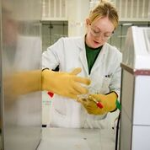
Job Family career pathway development case studies;
Jack Ross, Desktop Asset Analyst a member of the EIIS family. “I’ve found there has been a lot of opportunity for me to progress and I’ve been given access to technical training opportunities including technical certification. I can see the next steps in my career within CIS as a Technical Specialist.”
Kerry Strong, Teaching Laboratory Technician in the Department Of Chemistry a member of the TRTS family.
“The Apprenticeship Levy has given me the opportunity to continue my education whilst continuing to gain experience within the department. This in turn will hopefully stand me in good stead for the future in terms of progression. The Apprenticeship will also help me to improve on skills outside of my usual day to day work. Without the Apprenticeship Levy I probably would have chosen not to continue my education due to the cost of further education.”

Slide 22
Next steps – Development of career pathways
Career grades
  Discussions with Departments to introduce career grades to enable progression within the grading structure
Succession planning
  Recruitment of an Apprentice Electrician post by Accommodation and Commercial Services to assist with recruitment in a hard to retain area. Strategic aim is to recruit to retain by encouraging further progression on completion of training
Maximise the use of the Apprenticeship Levy
  Further organisational promotion of the use of the Levy to gain qualifications
  Investigation into the introduction of a Graduate scheme which will utilise the Levy in development

